Slide 1

“Business Process Automation” (BPA)
Internal Guide:
Aniruddhkumar G. Fataniya
(Assistant Professor)
Dipsi Dave
(Assistant Professor)
External Guide:
Mr. Nilesh Shah
(Assistant Vice President, Technology)
Prepared by:
Varshkumar Patel (14CE107)

Slide 2
Contents
What is BPA.
About BPA.
Need for BPA.
Project Plan.
System Requirements.
Functional & Non-Functional Requirements.
UML Diagrams.
Use Case Diagram.
Class Diagram.
Activity Diagram.
ER Diagram.
Conclusion.
Bibliography.

Slide 3
What is BPA
Definition by World Technology Forum:
Business Process Automation (BPA) is the technology-enabled automation of activities or services that accomplish a specific function or workflow. Business processes can be determined for many different segments of company activities, including sales, management, operations, supply chain, human resources and information technology.
Definition by Wikipedia:
Business Process Automation (BPA) is the technology-enabled automation of business processes. It is performed to achieve digital transformation or to increase service quality or to improve service delivery or to contain costs. It consists of integrating applications, restructuring labor resources and using software applications throughout the organization.

Slide 4
About BPA
A web application/portal that is built to maintain and analyze all the work done in company with few simple clicks.
Automate the process which can generate Daily/Monthly/Quarterly/Yearly revenue report and other reports to give detail insight to the multiple stakeholders.
This portal has role base and rule base access levels.
Generate reports on real time basis:
Based on daily work carried out by the company.
Based on the profit they make per project.
More than 21 such types of report can be generated.
Generated reports can then be saved as pdf file or can be mailed directly via SMS
Portal (Company’s intranet portal).

Slide 5
Need for BPA
At present, the company was working on offline files(i.e. Excel sheets) for maintaining the project record and details.
Sharing of the files was also required every time they make some change in the project or whatsoever.
The company was in need to make everything available about the project to them on real time basis.
Efficiency of any department and employee can easily be tracked and noted by the report generation portal.
Scheduling of projects within the company can be done easily with the help of this portal.

Slide 6
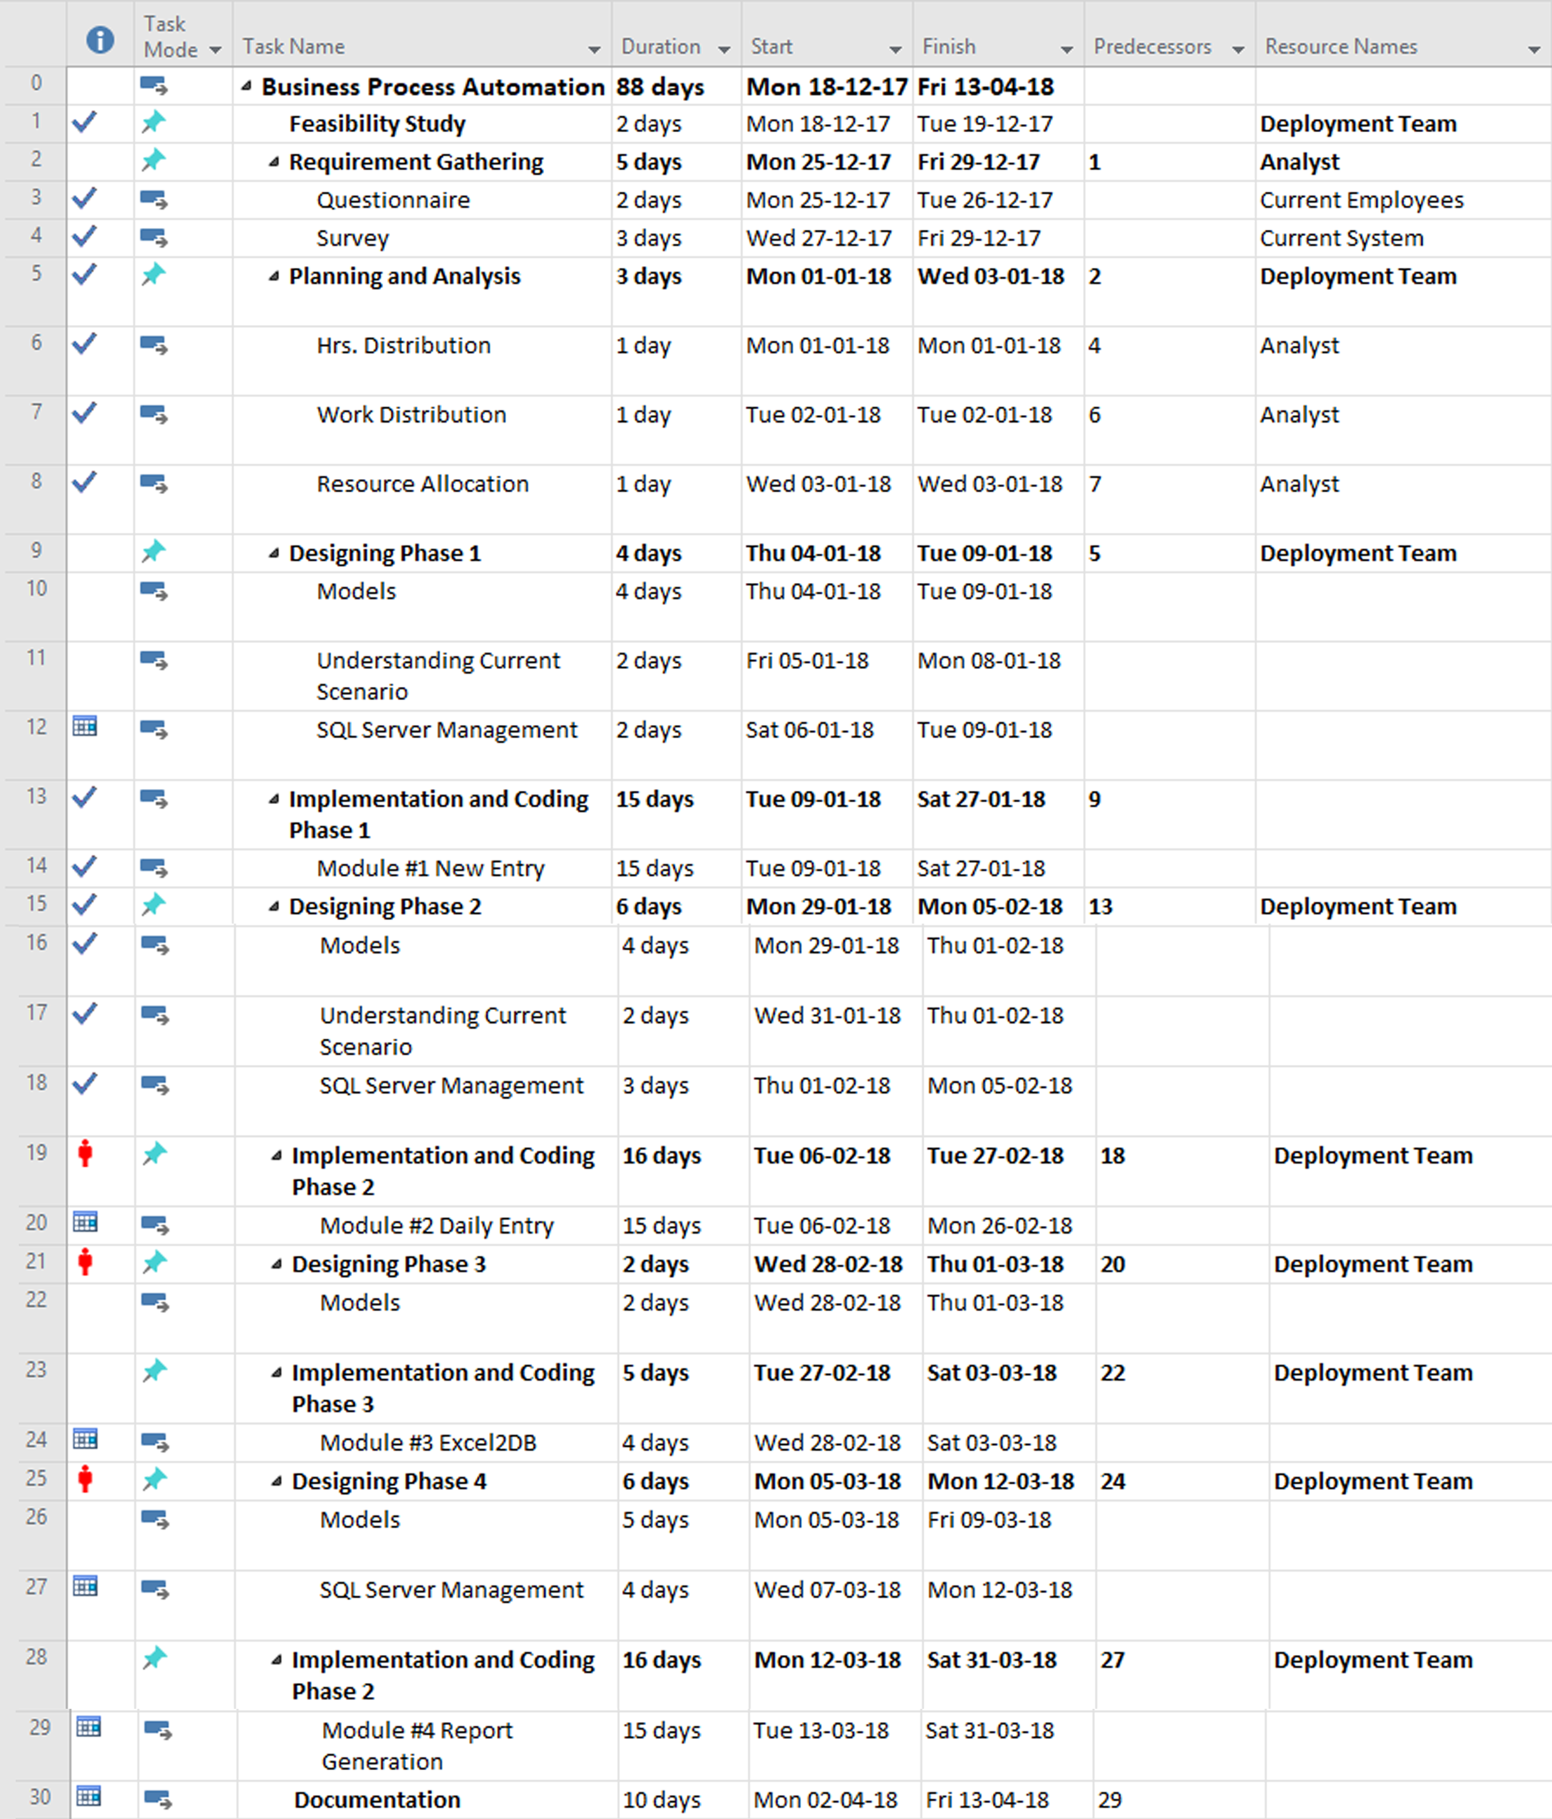
Project Plan

Slide 7
Project Plan Cont.

Slide 8
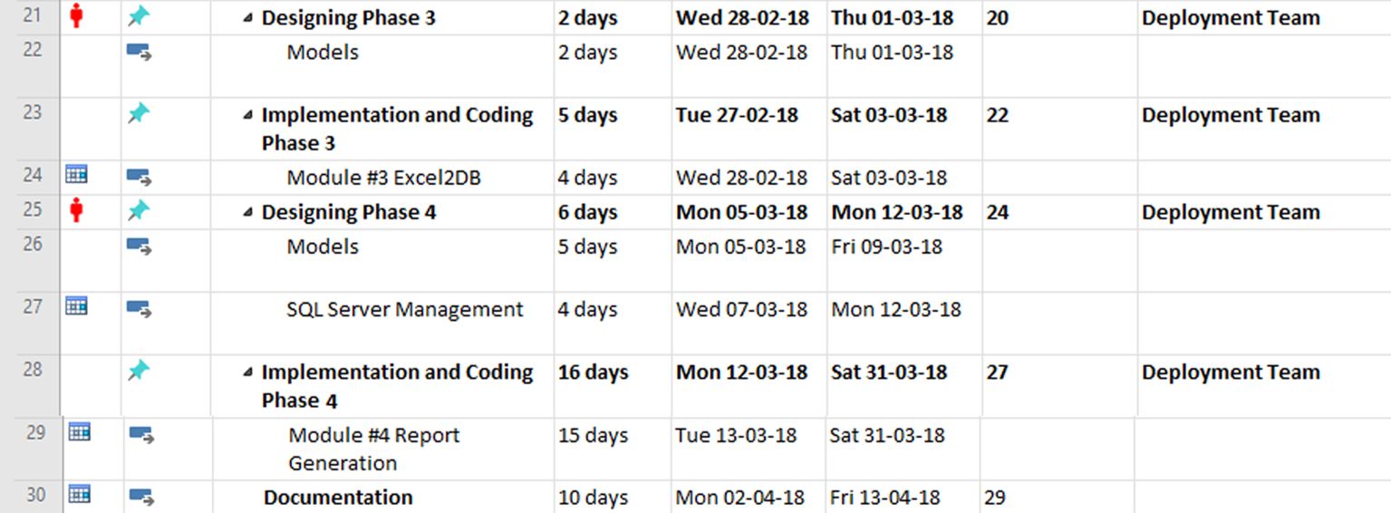
Project Plan Cont.

Slide 9
Requirements
Software Requirements:
Visual Studios 2013 Ultimate.
.NET Framework 2.5
MYSQL Workbench.
SMS Portal(Company’s intranet portal).
Hardware Specification:
Windows OS 64-bit system, 8GB RAM, 1TB HDD.
Azure B+ OS(Linux Based), 64-bit system, 6GB RAM, 1TB HDD.

Slide 10
Functional Requirements*
New Project Entry.
Daily Work Entry.
By Employee ID
Per Project ID
New Project Details.
If not only present.
Excel 2 DB.
Connection String.
Sheet name in Excel file.
Database name to enter to.
Report Generation.
21 different types of report on real time basis.
*New Modules may add up further as per requirement.

Slide 11
Non - Functional Requirements
Reliability.
Efficiency.
Security.
Availability.
Portability.

Slide 12
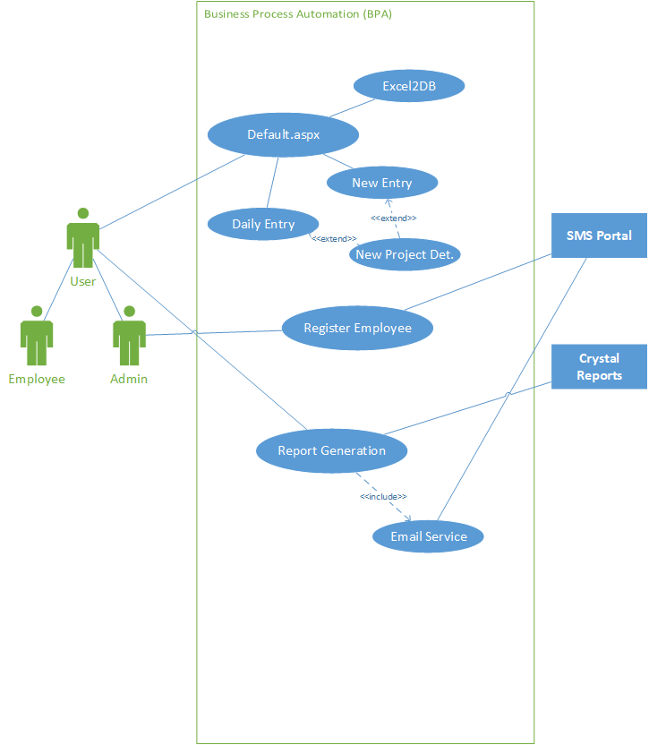
Use Case*
*New Modules may add up further as per requirement.

Slide 13
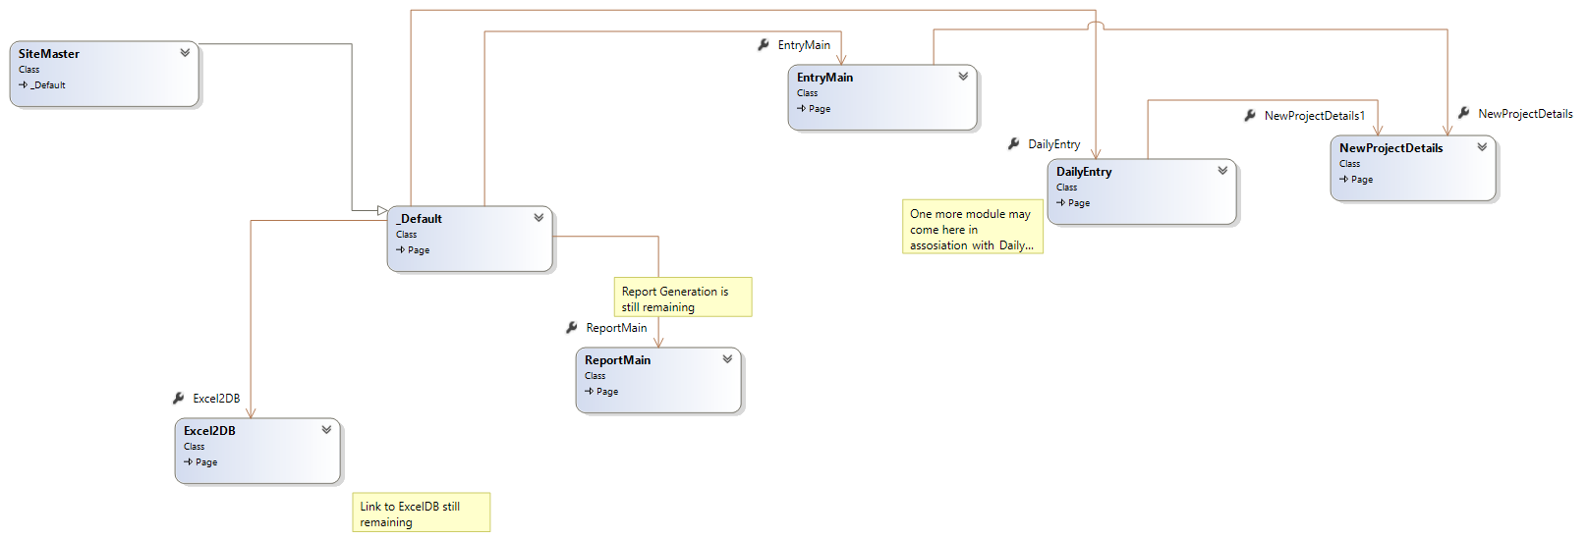
Class Diagram* Shortened
*New Modules may add up further as per requirement.

Slide 14
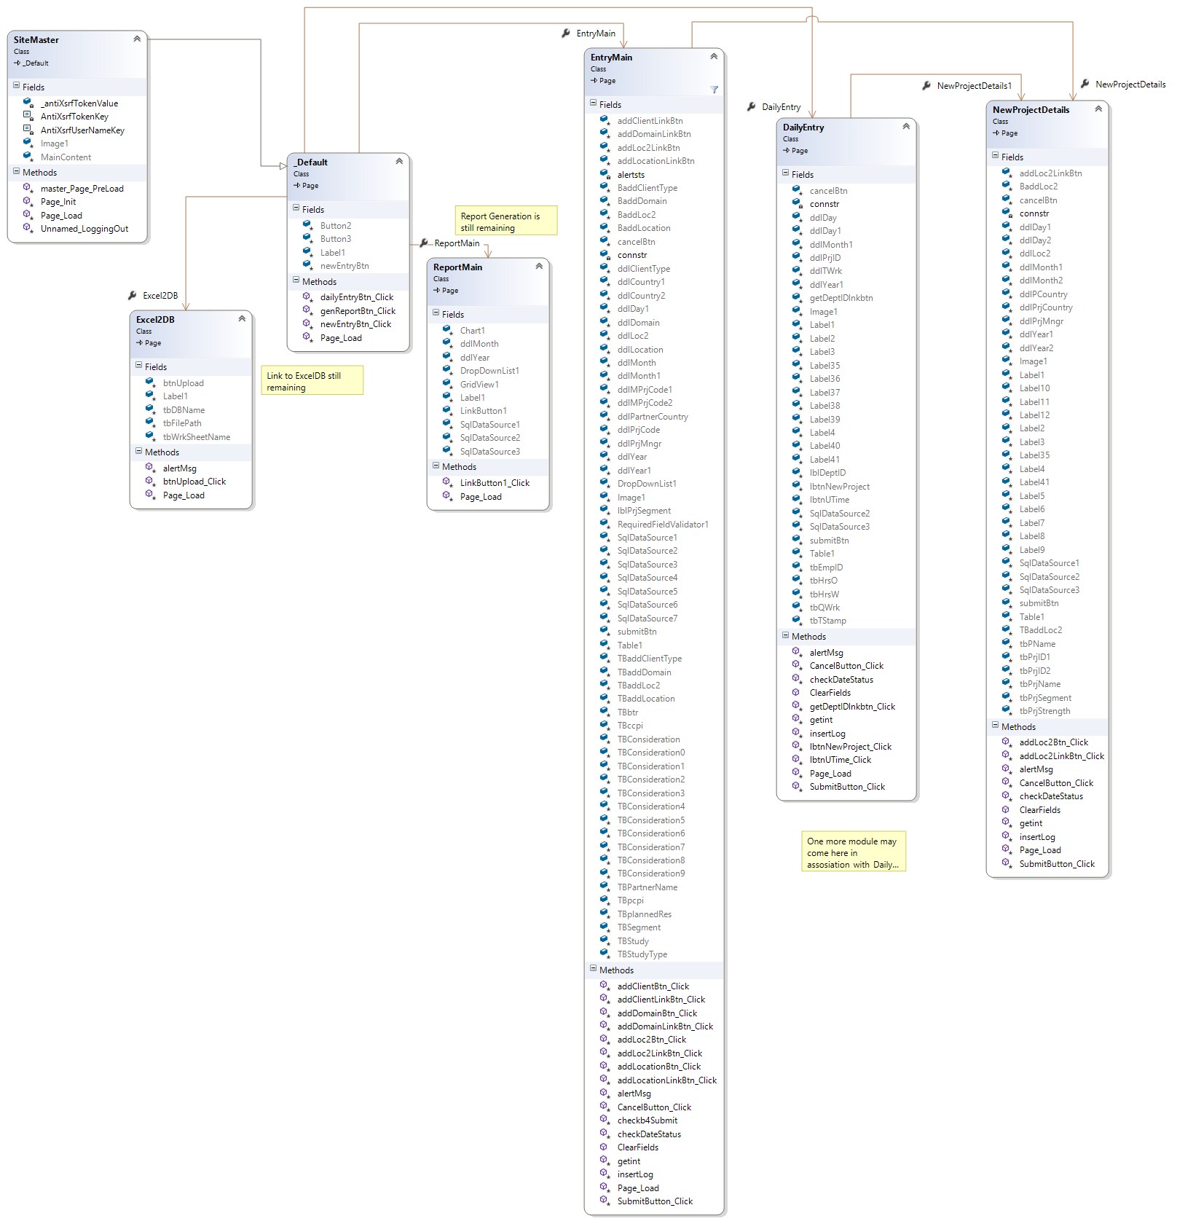
Class Diagram* Extended
*New Modules may add up further as per requirement.

Slide 15
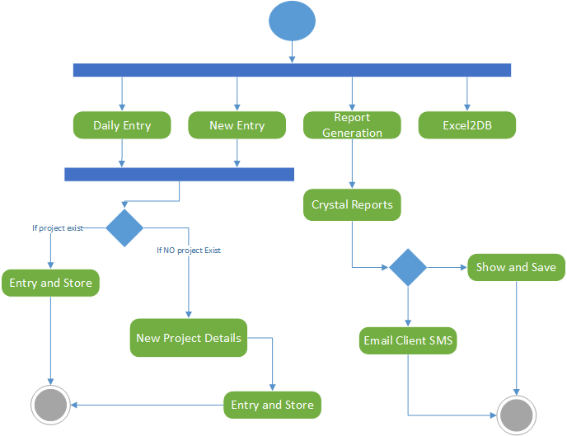
Activity Diagram*
*New Modules may add up further as per requirement.

Slide 16
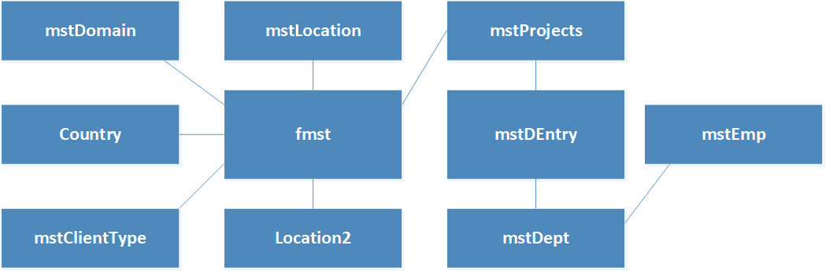
ER Diagram* Shortened
*New Modules may add up further as per requirement.

Slide 17
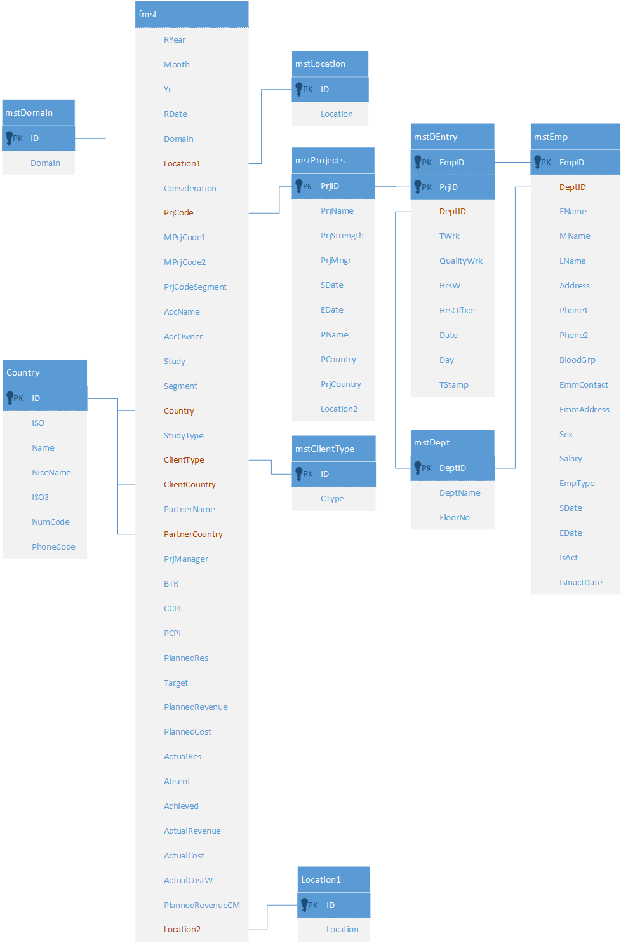
ER Diagram* Extended
*New Modules may add up further as per requirement.

Slide 18
Conclusion
It is a web based portal that will help the company to automate every single process carried out in the company.
From sharing excel files to creating new project on company’s portal will be handled by the BPA portal itself.
It has the capability to merge with current portal for communication i.e. SMS Portal on company premises.

Slide 19
Bibliography
https://docs.microsoft.com/en-us/dotnet/csharp/getting-started/introduction-to-the-csharp-language-and-the-net-framework
http://csharp.net-informations.com/crystal-reports/csharp-crystal-reports-stepbystep.htm
https://dev.mysql.com/doc/
https://www.codeproject.com/Questions/1169094/Crystal-report-in-Csharp-windows-application
http://azureknowledge.com/

Slide 20
THANK YOU !

